Slide 1
GENDORG: A Generic Data Organizer & Post-Processor
H. Murat Panayirci

Slide 2
What is Gendorg?

Slide 3
Gendorg
Gendorg: A Generic Data Organizer & Post-Processor
It is a simple tool developed in Matlab App Designer with some basic features which can be extended according to specific requirements
This tool is useful if you:
- perform experiments systematically and collect large amount of data
- want to create a database with all performed tests while keeping track of selected experiment parameters
- want to avoid repetitive manual labour for post-processing data and generating plots
- want to be consistent in terms of the processing of data when more than one person is using the test equipment
- want to have the data all in one place
All the above points are also valid if the data is generated from numerical simulations

Slide 4
Implementation

Slide 5
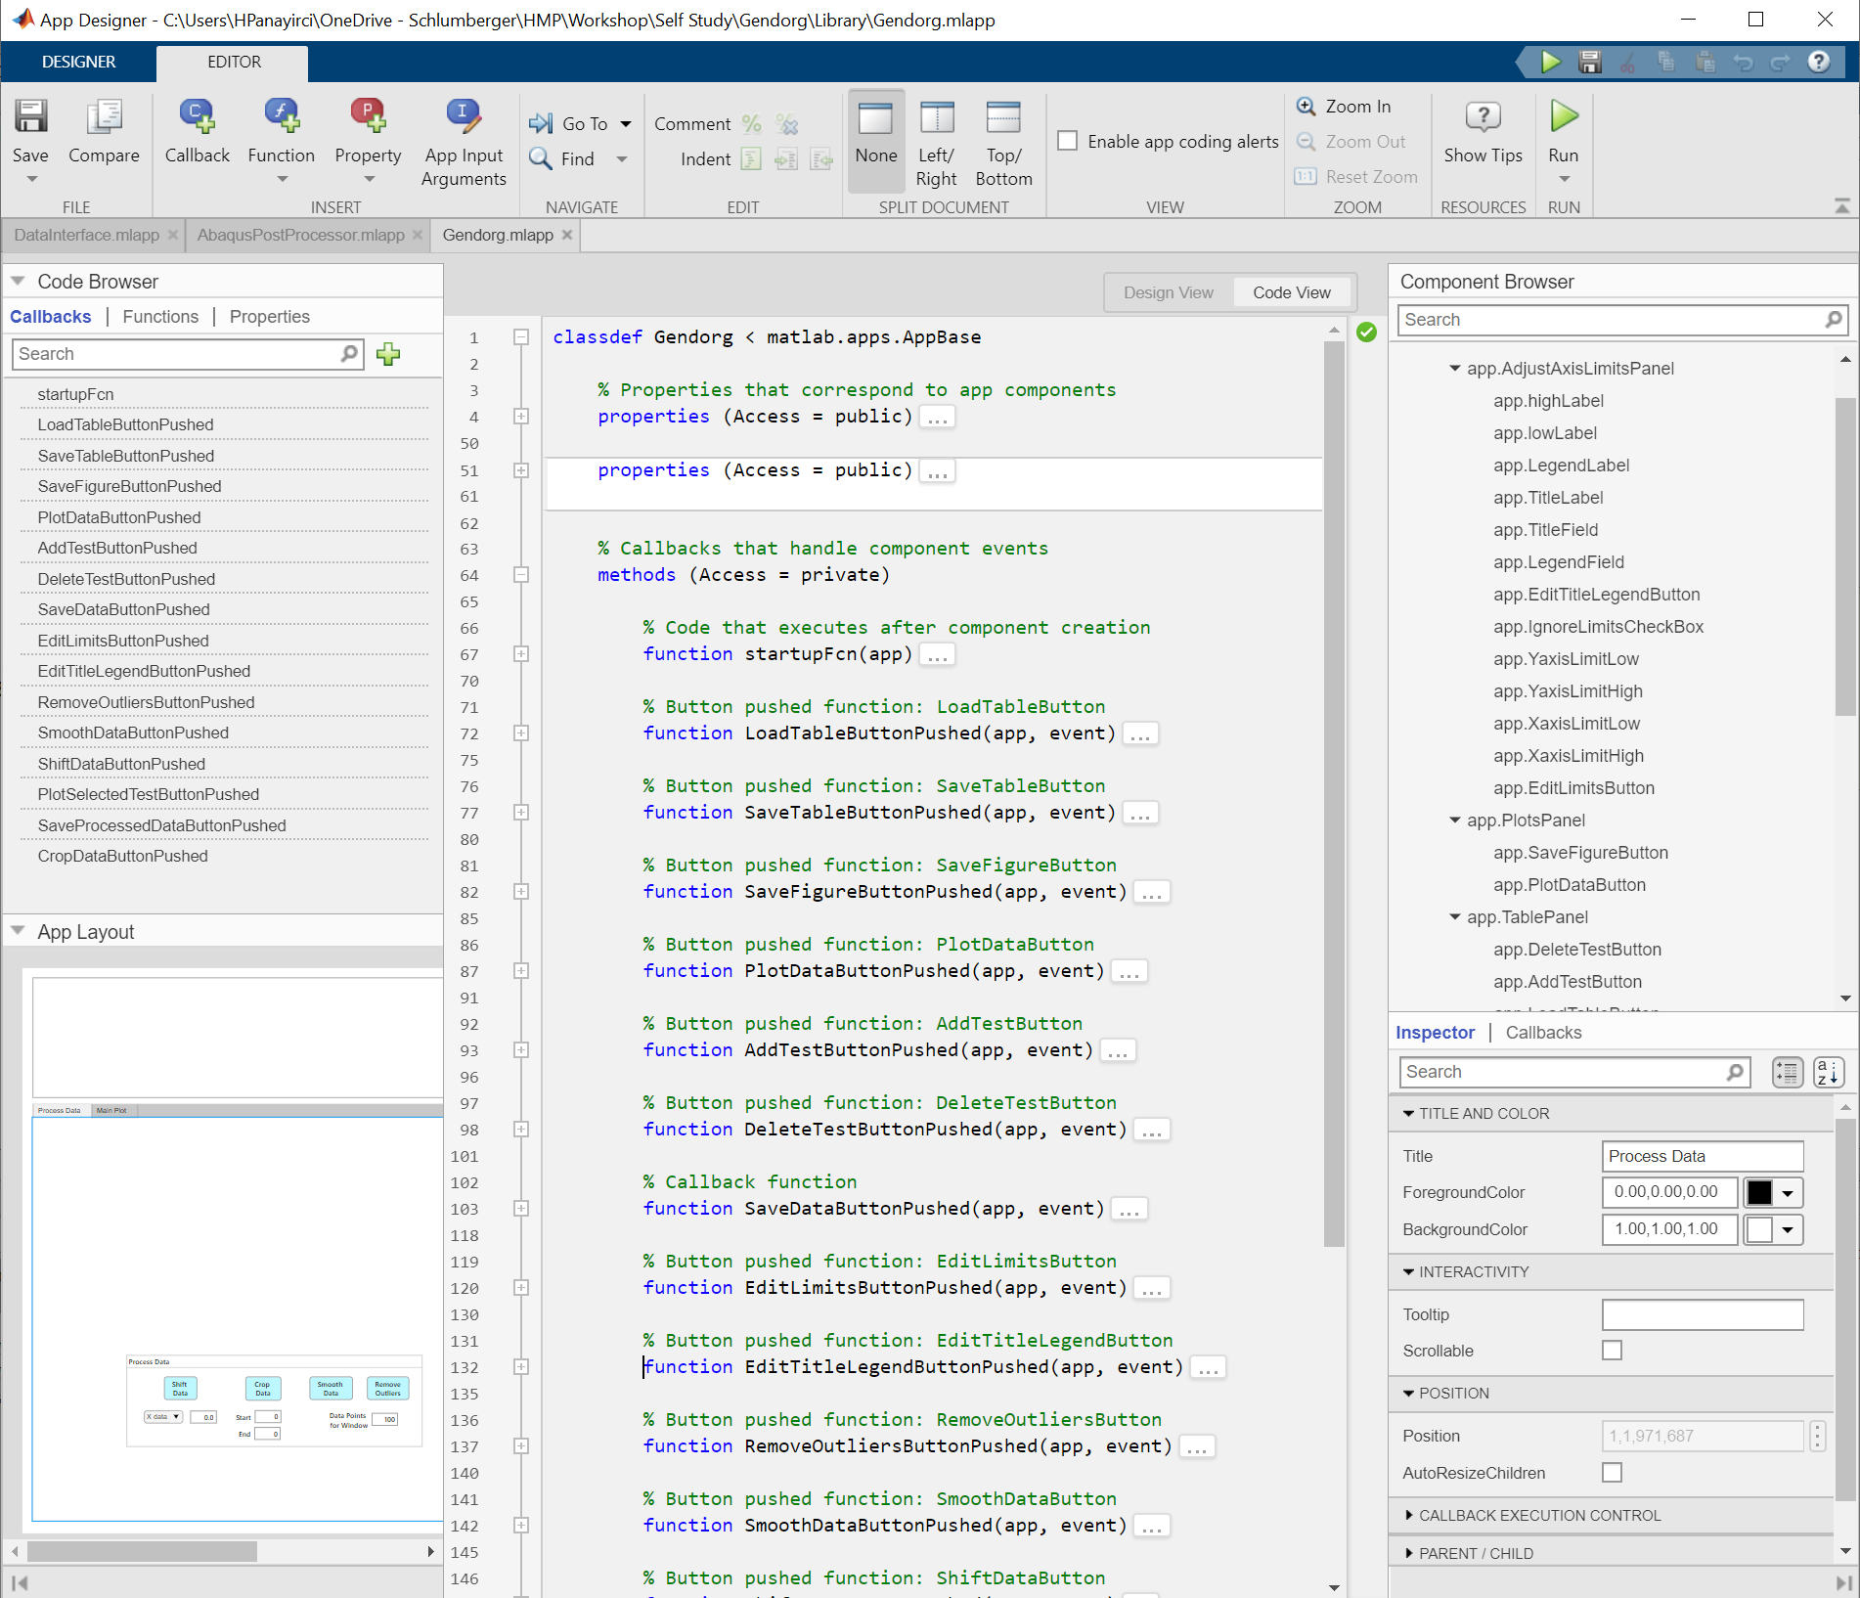
Matlab App Designer – Code View
GUI can be started here
View can be switched here between Code and Design
All functions created for the interface listed here
List of created components, e.g. labels, edit fields, buttons, etc.
Properties are set here
Main code editor (an object oriented style is imposed)

Slide 6
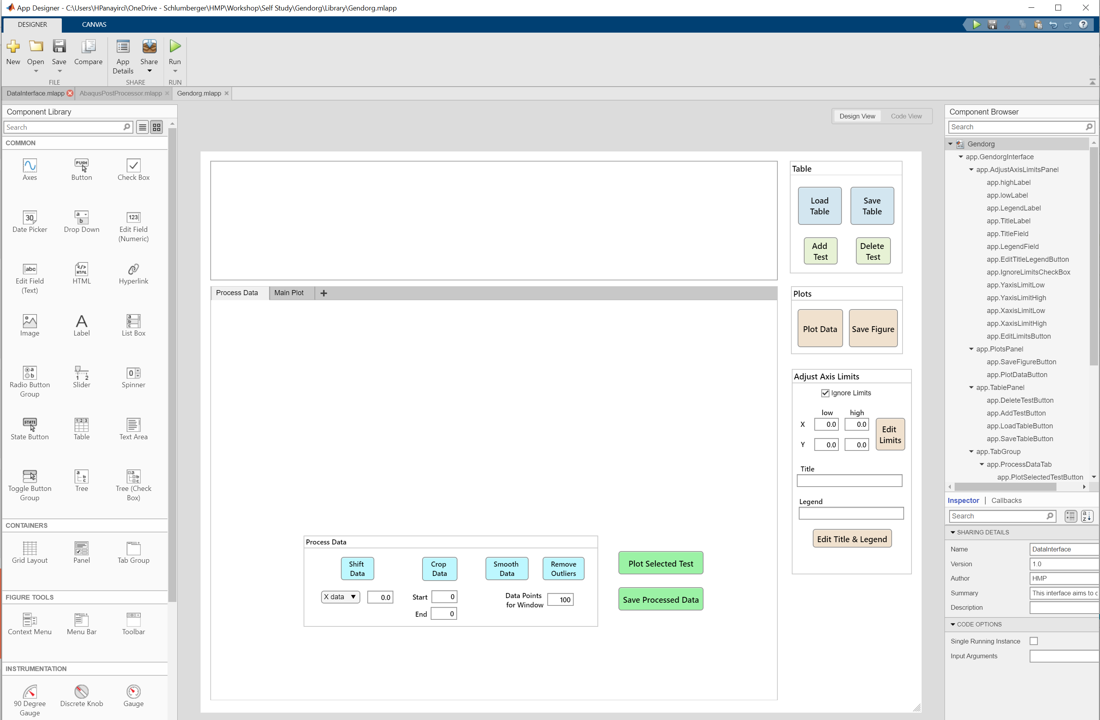
Matlab App Designer – Design View
Library of components can be simply dragged on the GUI
Designed interface

Slide 7
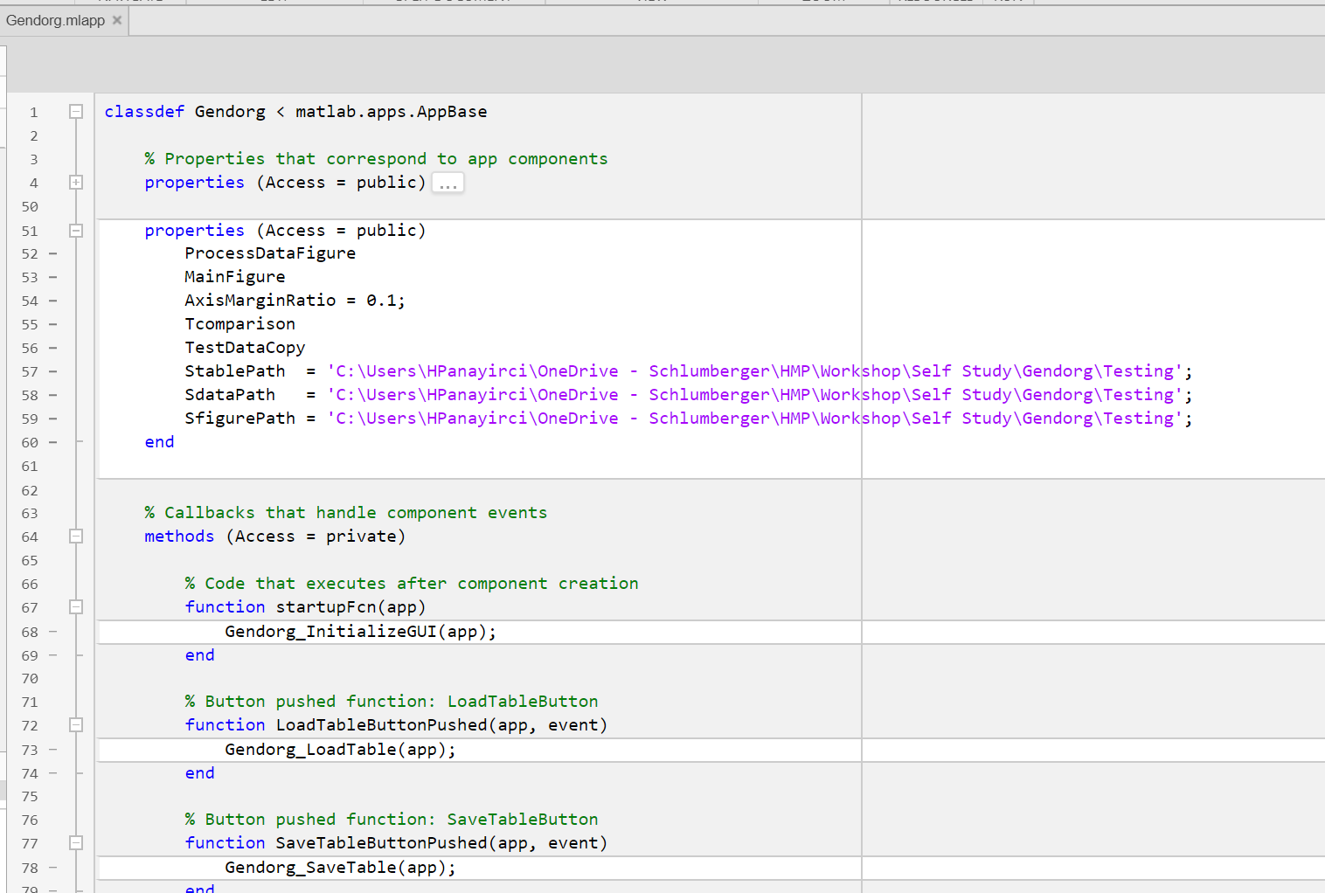
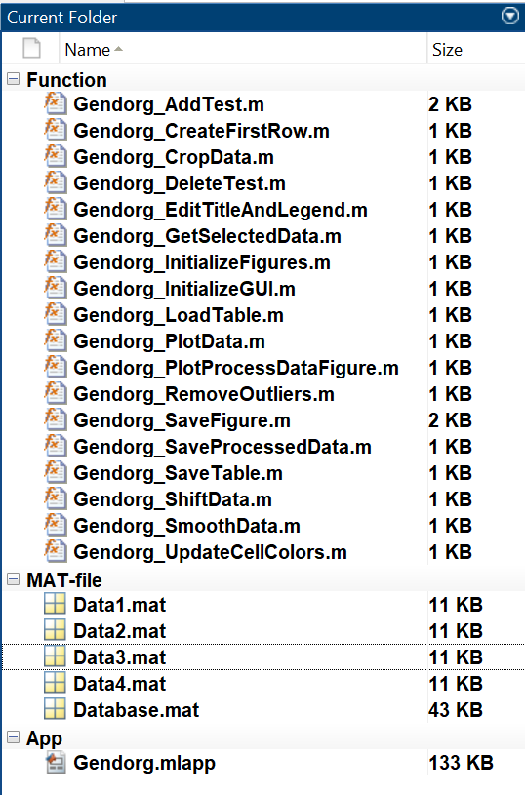
Matlab App Designer – Design View
Fields of the “app” object created by the user
Can be accessed in any function defined within methods
No need to define “app” as an output when creating methods, i.e. its behaves as if it is global variable
Functions created for this implementation
code can be edited here or a function can be called
The editor has auto-completion features, which makes it convenient to code here (similar to live scripts). However the editor becomes really slow if the no of lines > 1000. Therefore if you are planning to develop an advanced interface, it is better to move the code into matlab functions

Slide 8
Features & Capabilities

Slide 9
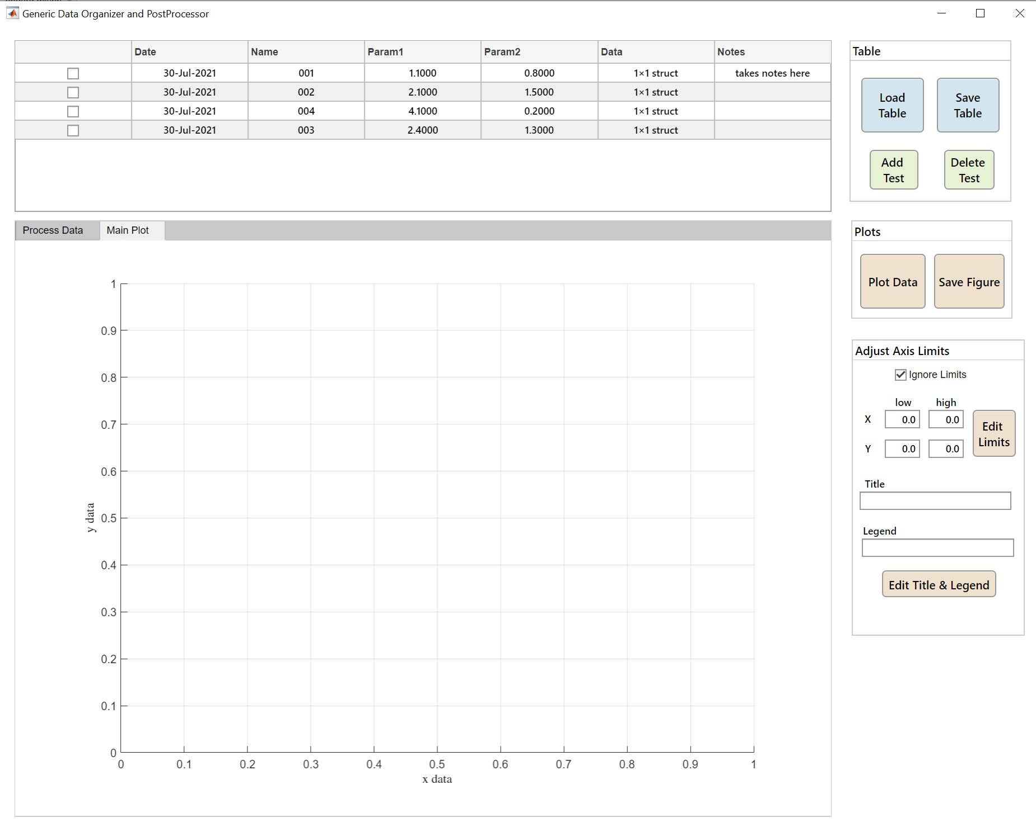
Gendorg
A structure variable can be used to store multiple time series data (e.g. IDEAS rock lab data since 2005 has been stored in a single table, comprising more than 20,000 tests, each with multi-channel measurement data, resulting in ~12GB file)
Main table where test/simulation data can be added together with parameters
As the table is populated with more tests/simulations, the rows can be sorted according to date, parameters, etc.
More tabs can be designed, each dedicated to specific group of tasks or plots
Plots can be generated on the interface or in separate windows

Slide 10
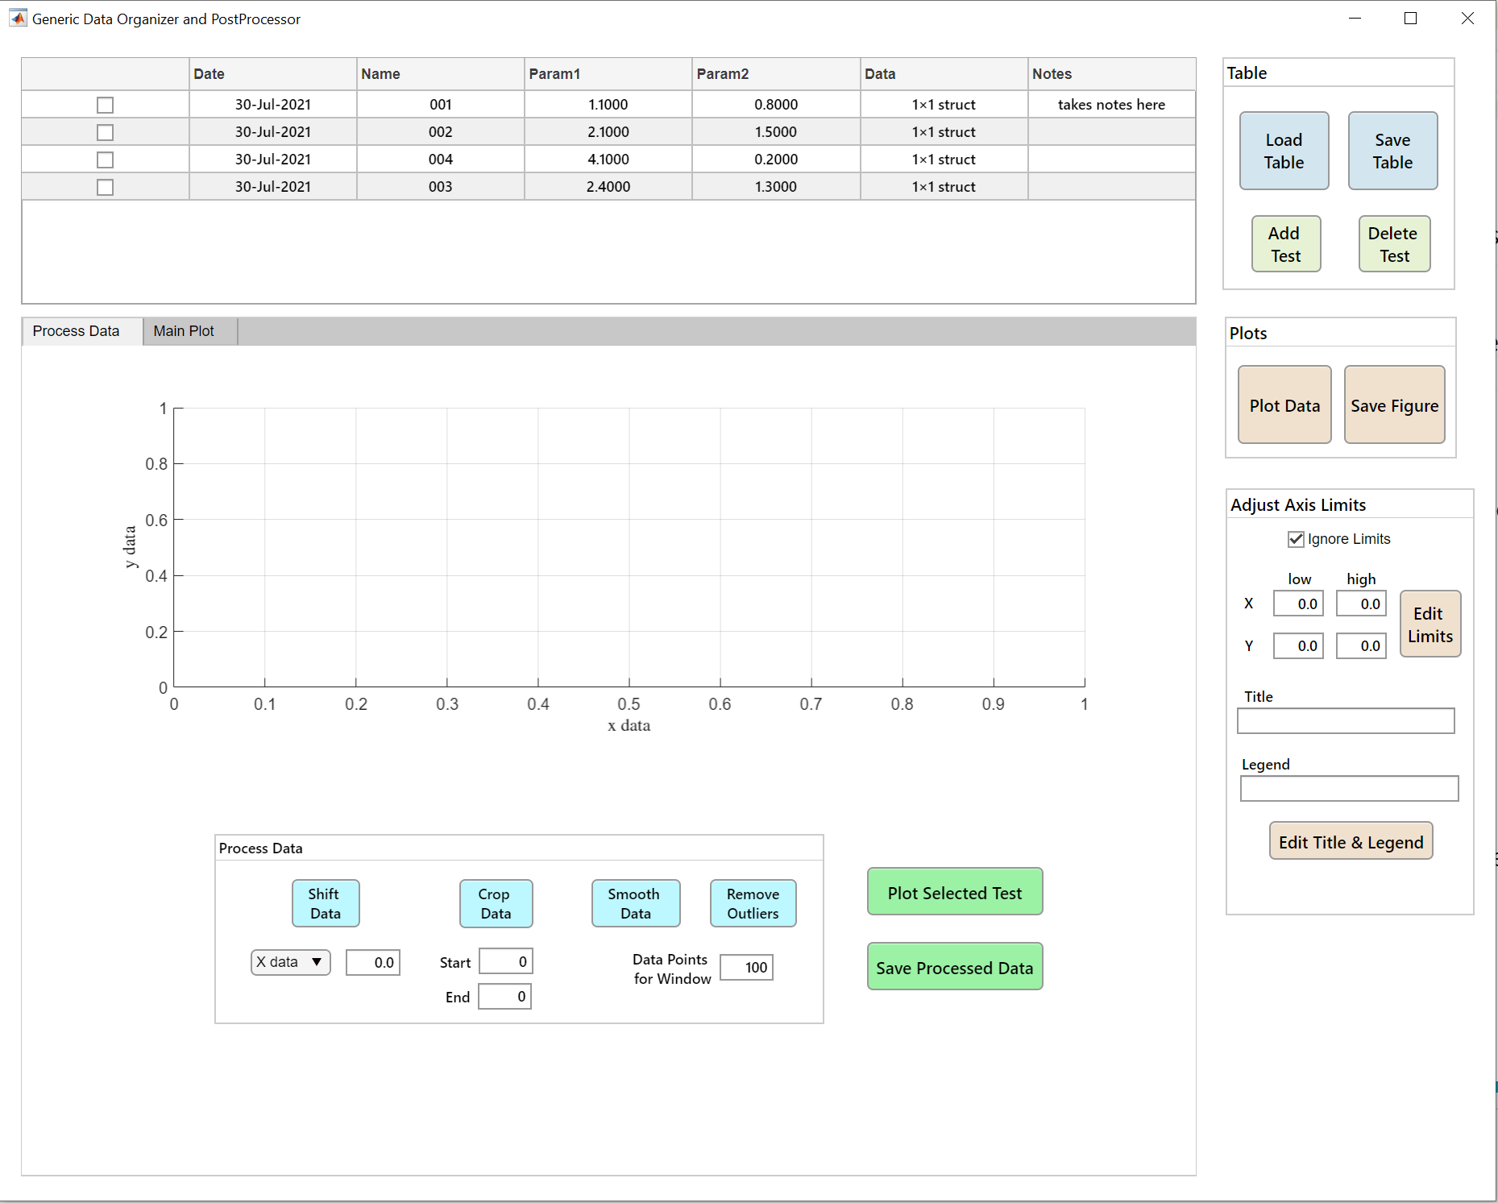
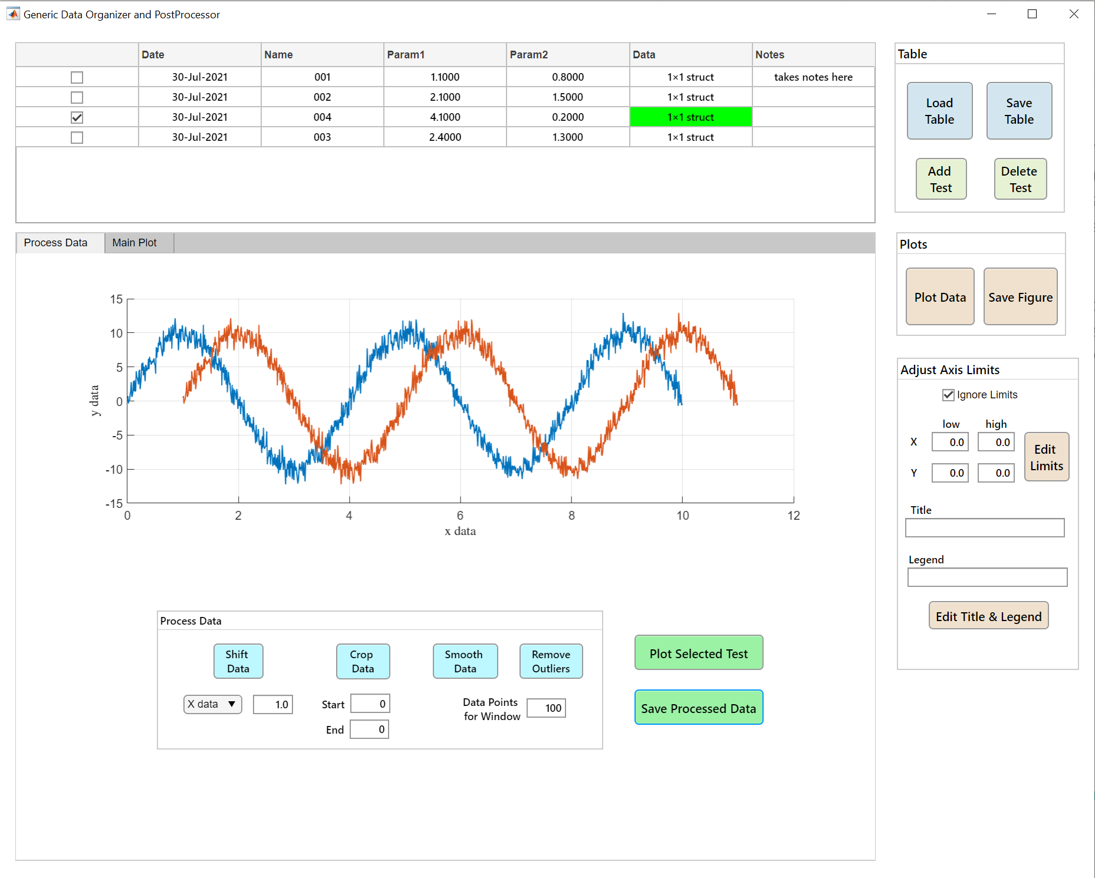
Gendorg
Experimental data typically needs some sort of post-processing
Repeated procedures applied to channels can be made more practical by including a dedicated post-processing tab
Although it is possible to fully automate this type of processes, usually one needs to observe the changes applied to raw data to ensure the integrity of the results
Here some of the most common processing steps applied to experiment data are included with dedicated buttons
A flag can be used to mark the tests which have been already cleaned/processed. These flags can be then used to mark these tests for user-friendliness

Slide 11
Demo

Slide 12
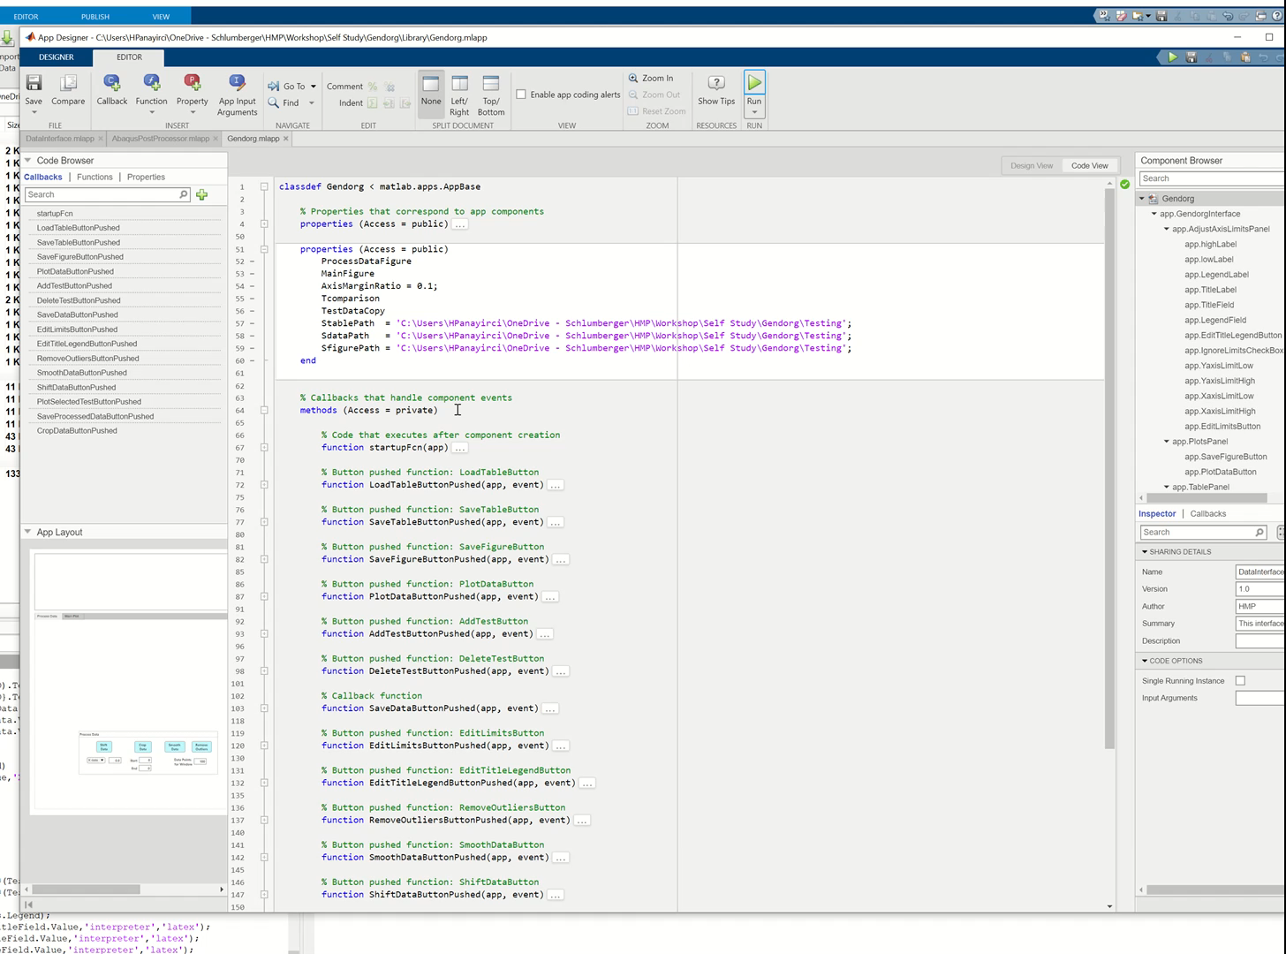
Gendorg

Slide 13
Source Code

Slide 14
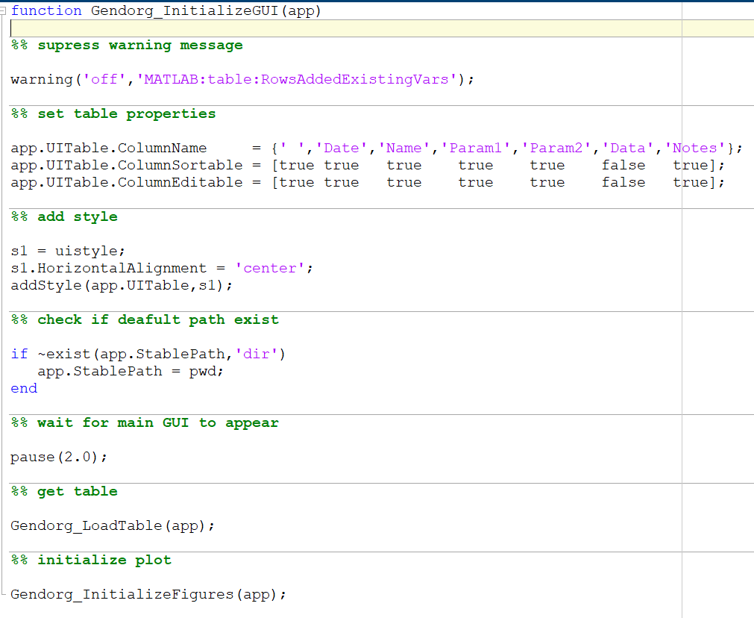
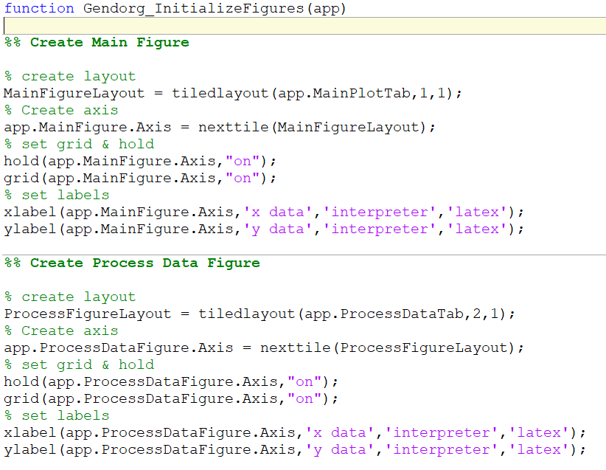
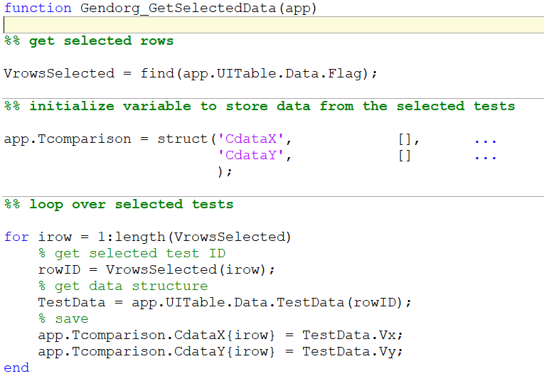
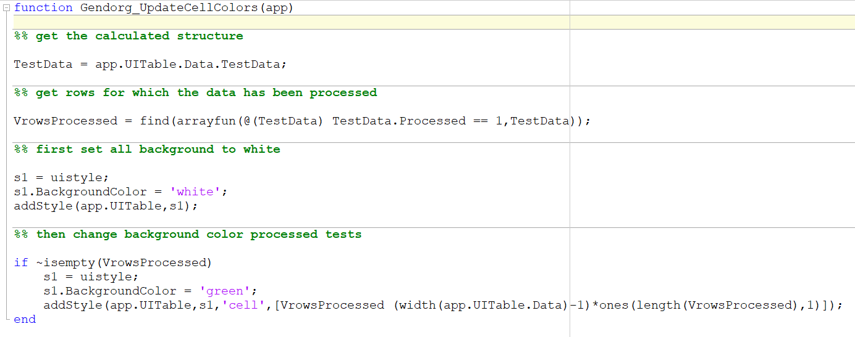
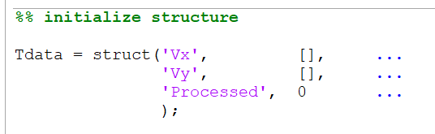
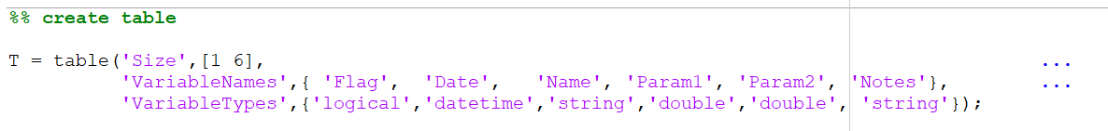
Gendorg

Slide 15
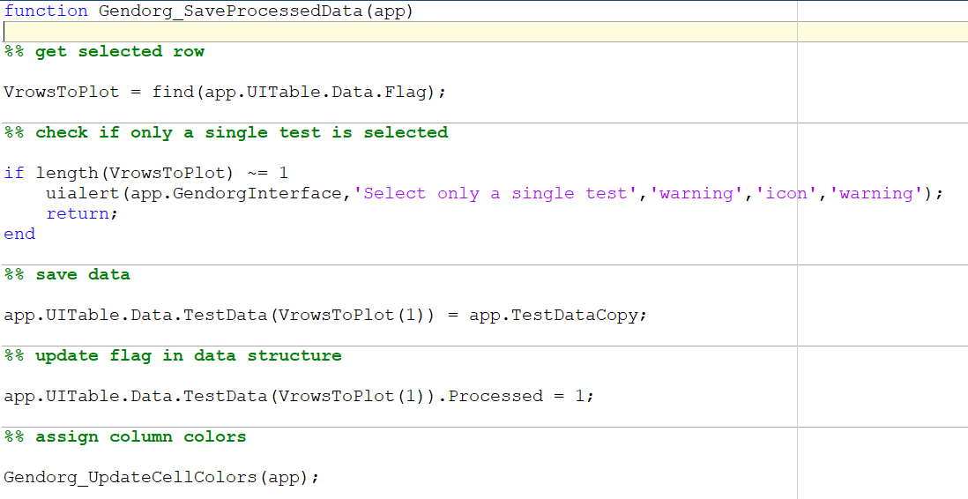
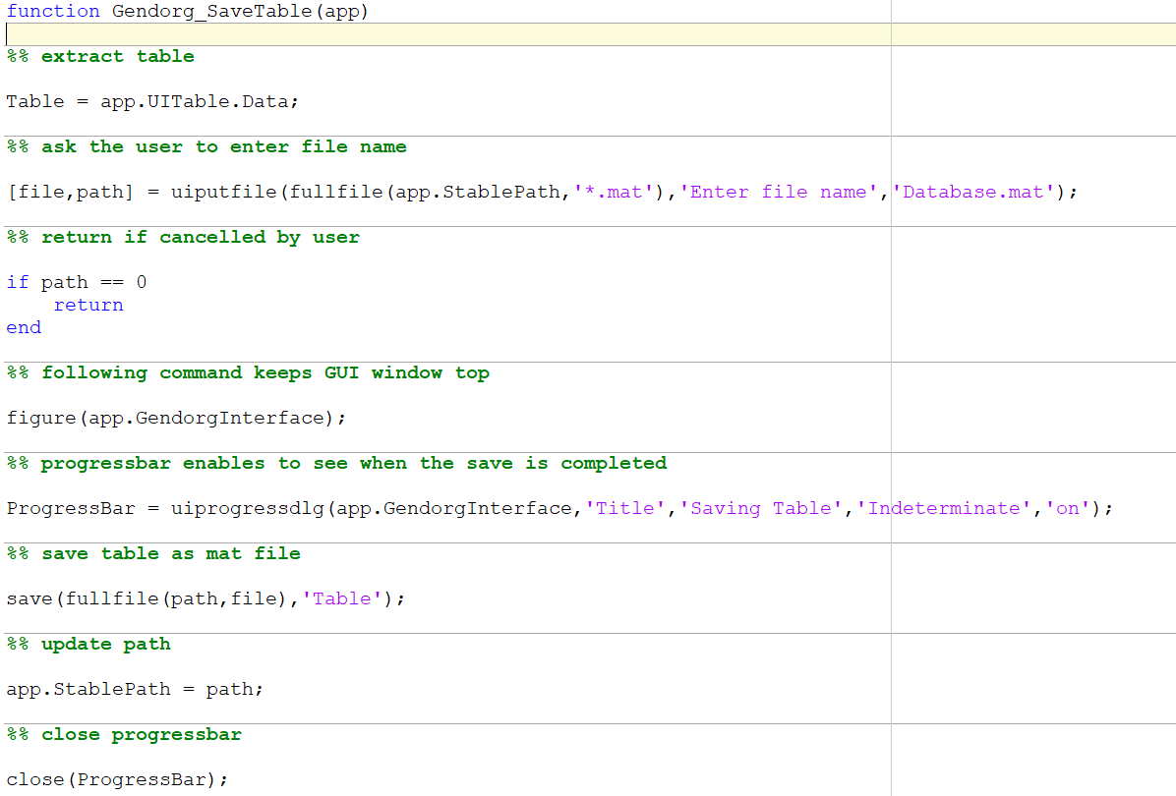
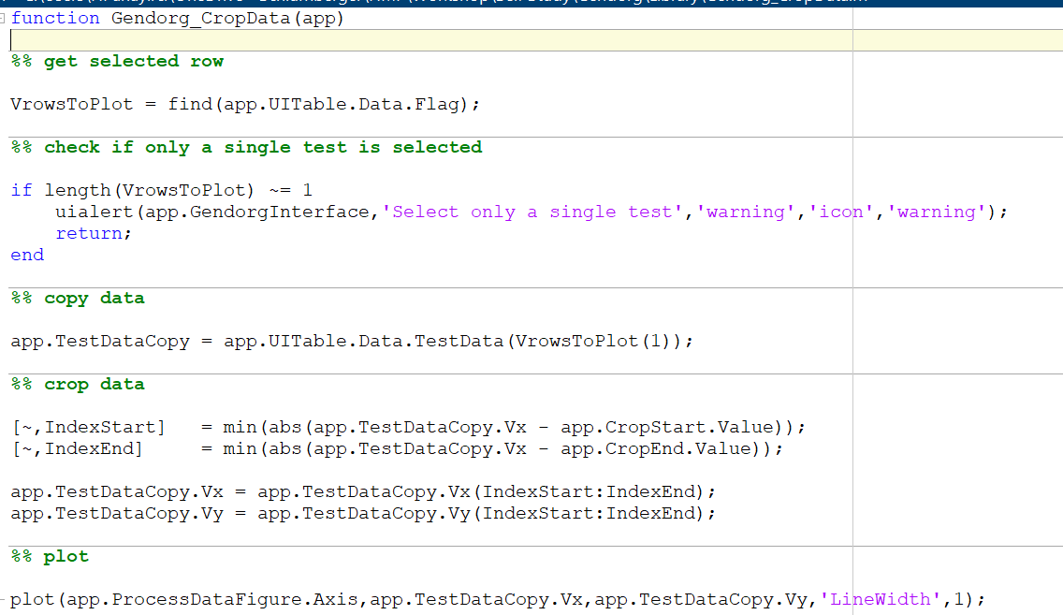
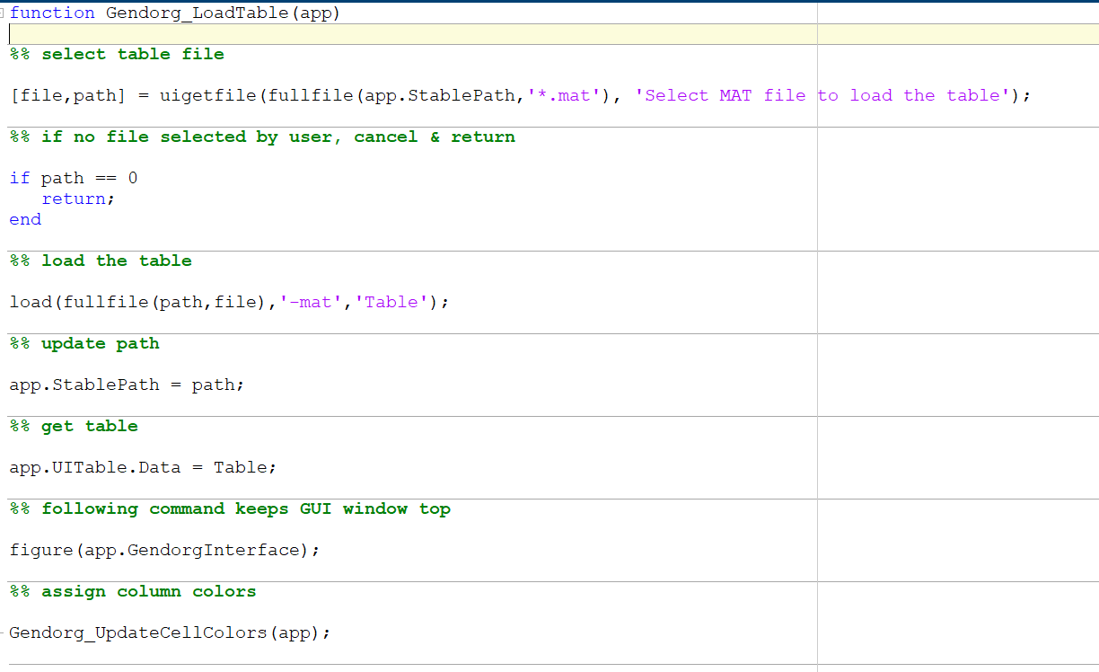
Gendorg

Slide 16
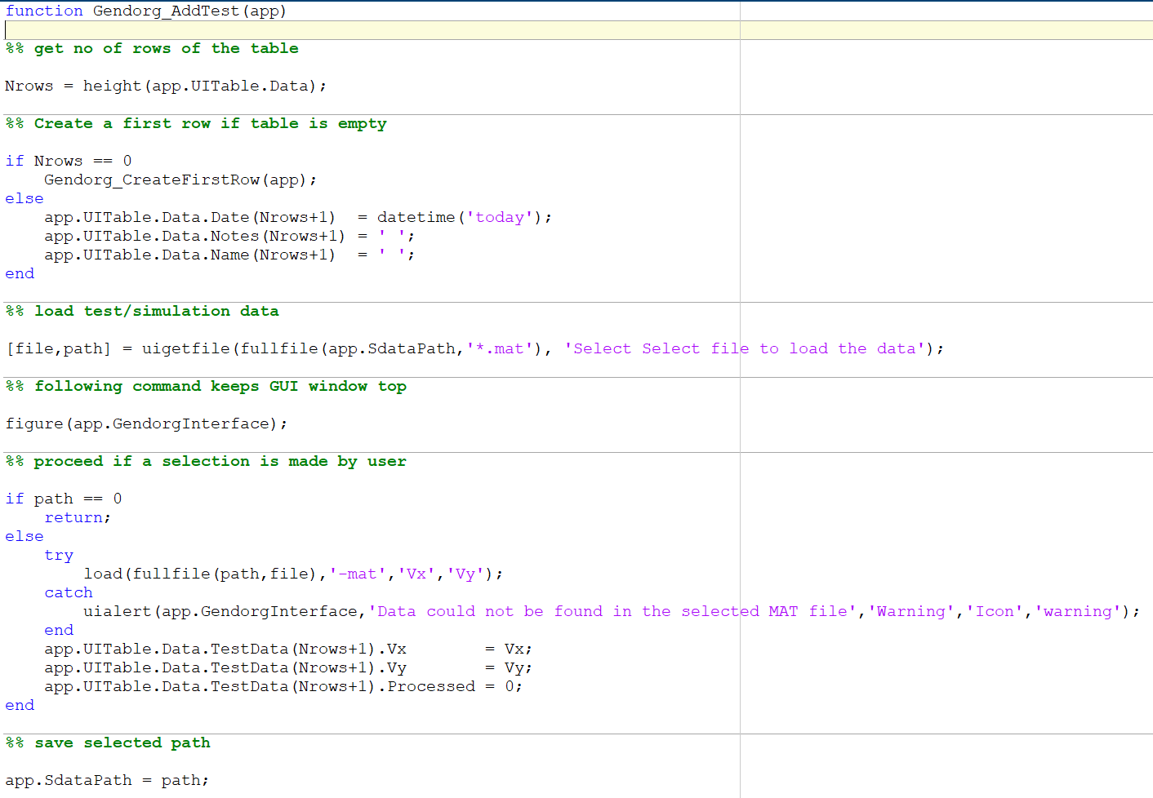
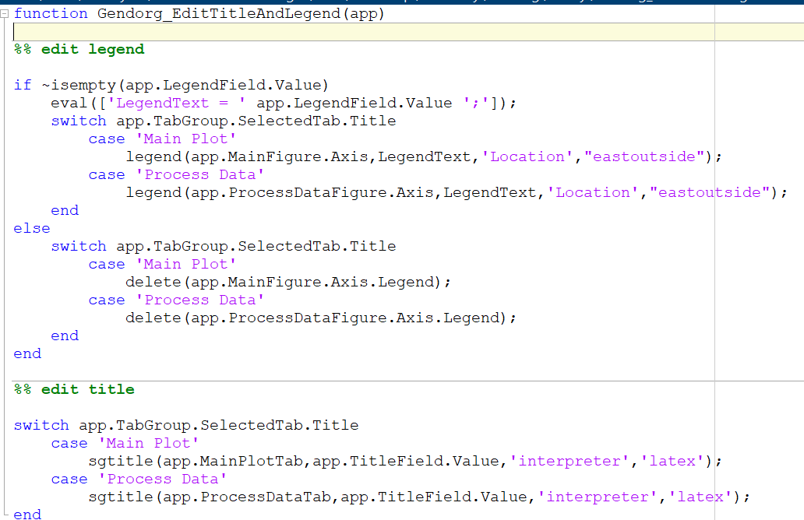
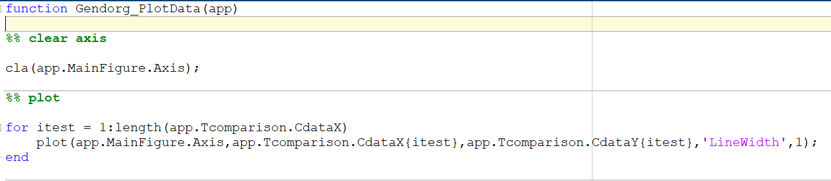
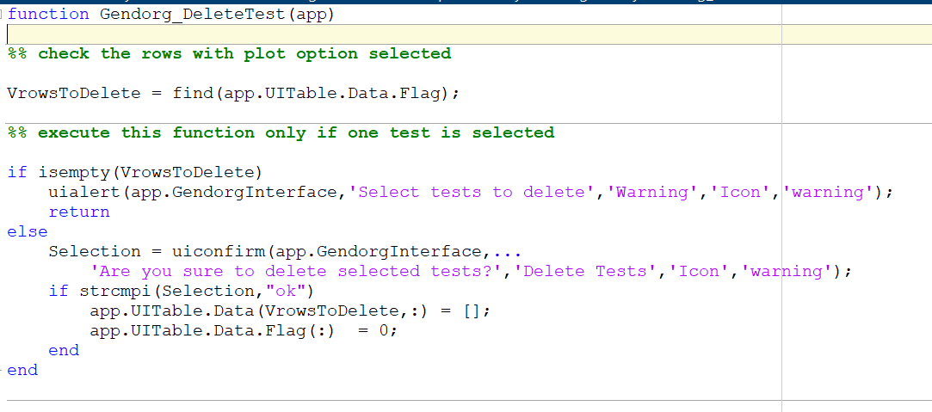
Gendorg

